Slide 1
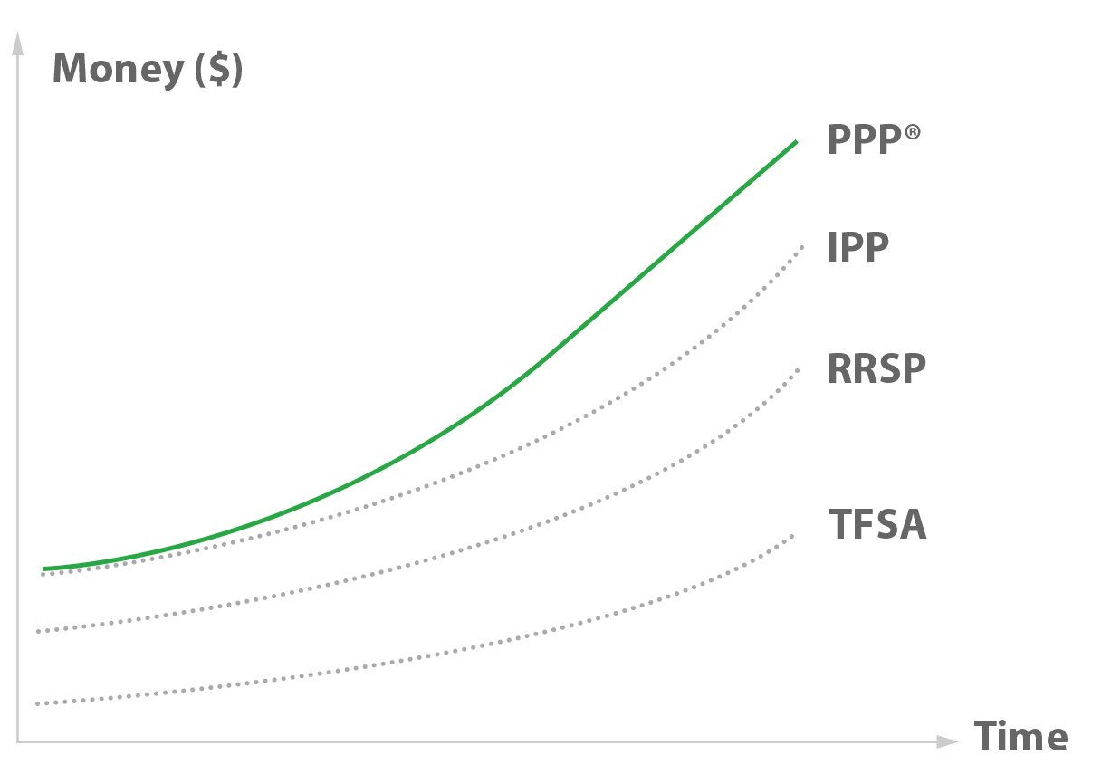
A Case Study for The INTEGRIS Personal Pension Plan

Slide 2
Claude is a…
Small business owner, franchisee and incorporated professional

Slide 3
Claude wants to
Build the largest retirement ’nest-egg’ as possible while claiming the largest tax deductions

Slide 4
Facts
Claude is 45
The business pays T4 of $125,000
Been in business since 1995
Company always pays $125,000 in salary/bonus
Claude has $400,000 in RRSPs at Assumption Life
Claude is fairly conservative and picks a basket of funds to ensure at least a 5% return each year.
Wants to retire at 71 (to defer paying taxes)
Company pays tax at 26%

Slide 5
Executive Summary
Big picture: PPP enhances the registered assets available by age 71 by $1.6 M !
All else being equal, we start with what an RRSP can deliver, and add $1.6 M for client to enjoy in retirement.

Slide 6
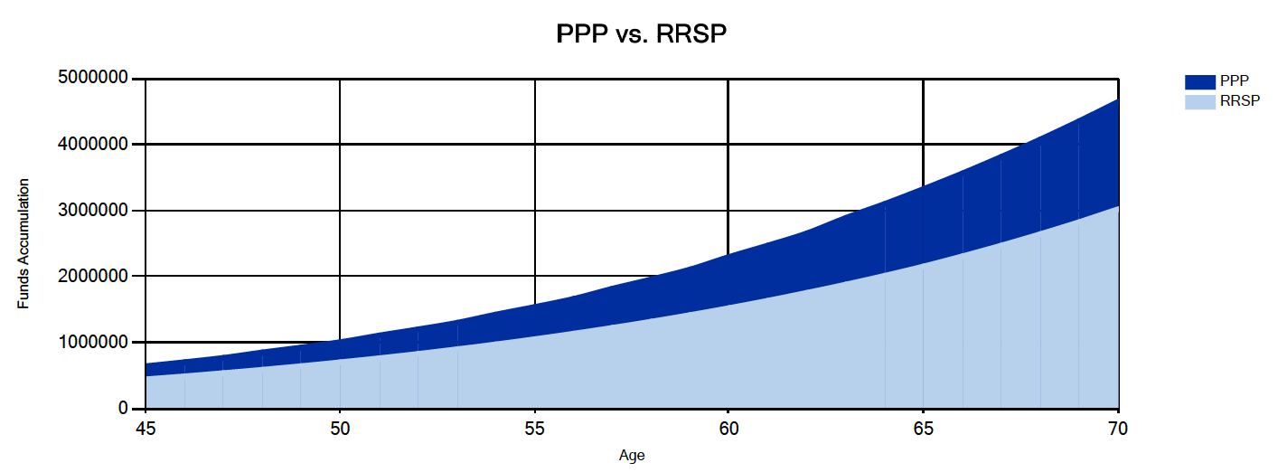
Graphically: Gap is $1.6M

Slide 7
How is that possible?
PPP laws allow for more contributions than RRSP rules.
How Much? $733,053

Slide 8
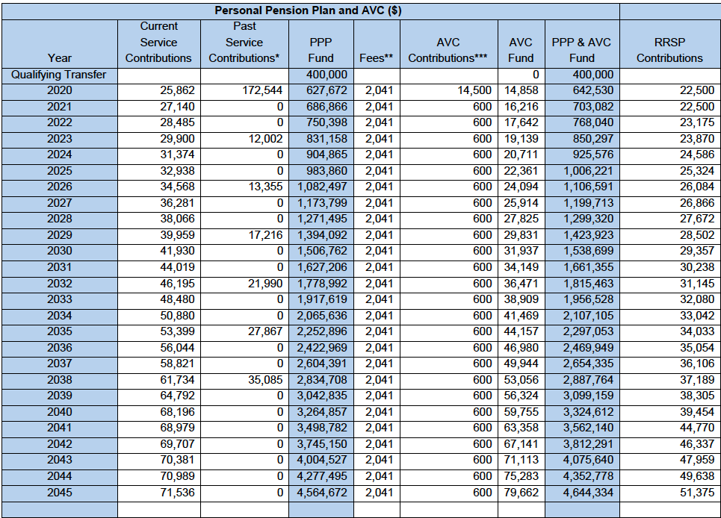
What are the sources of these extra PPP contributions?
Annually, the PPP allows you to contribute more than an RRSP.

Slide 9
Example: in 2033…$48,480 vs $32,080 [+$16,400]

Slide 10
Every 3 years, because assets are only growing at 5%, extra contributions permitted…

Slide 11
Extra Personal Tax deductions also permitted…

Slide 12
What do all of these additional contributions add up to?
Answer: $733,053 more than an RRSP…

Slide 13
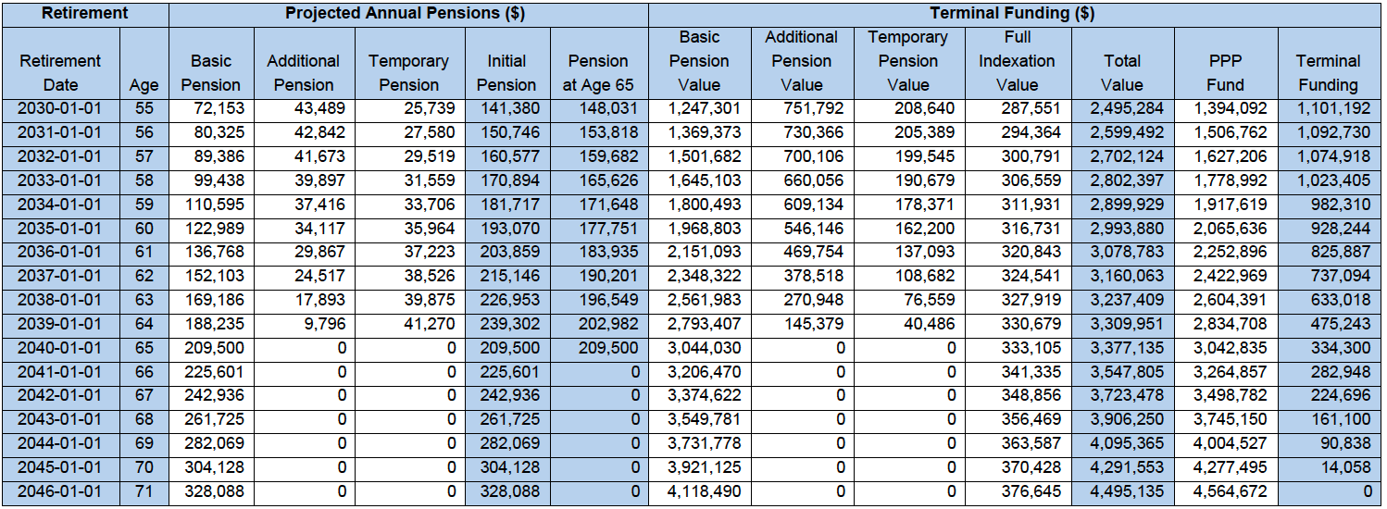
What if Claude decides to retire before age 65? Any other contributions? YES… it is called “terminal funding”

Slide 14
Terminal Funding Explained
Assume Claude retires at 58 instead of 65…

Slide 15
Terminal Funding Explained
Claude would, by 2033, be entitled to an annual pension of $99,438

Slide 16
Terminal Funding Explained
But if the company contributes $1,023,405 via terminal funding (a tax deduction for the company)….

Slide 17
Terminal Funding Explained
Instead of $99,438 a year, Claude can collect $170,894 a year (+ $71,456 or 72% more pension!!)

Slide 18
Terminal Funding Explained
As a bonus, the company just pocketed a tax savings of $266,085… [$1,023,405 x 26% corp. tax]

Slide 19
Is there more? YES.. Investment management fees are also tax-deductible to the company.

Slide 20
If fees/commissions add up to 2% of assets under management per year…this translates into additional tax deductions for the company!!!

Slide 21
Example: in 2030, AUM = $1,538,600

Slide 22
Example: if Fees are 2% of AUM = $30,773

Slide 23
Example: Since corp. pays tax at 26%, tax savings equals $8,001. [$30,773 x 26% corp. tax.]

Slide 24
Example: Tax savings of $8,001 is almost 4 times the annual fee!!!

Slide 25
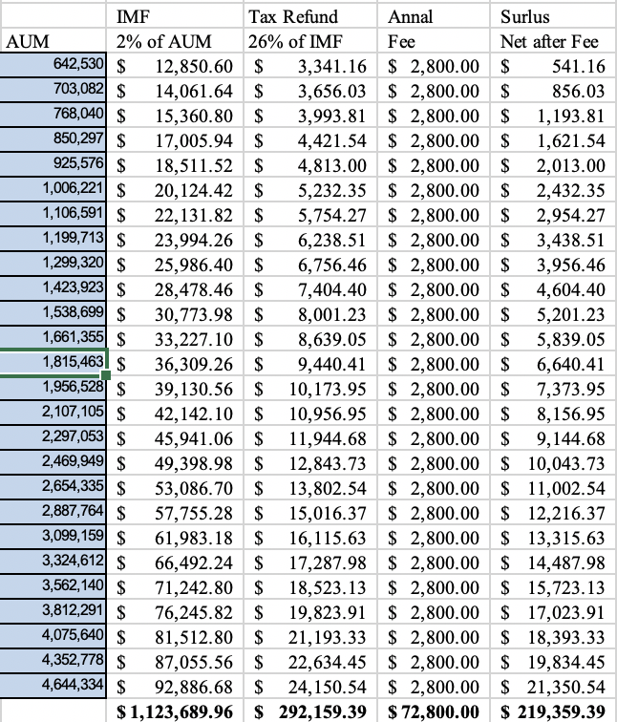
What about IMF tax refunds over the entire time-frame?

Slide 26
Is there more?
Claude’s pension at age 58 is $170,894
But Claude is married and can do ‘pension-income splitting with a spouse’ at that age.
Claude would only declare income on $85,447 [50% of annual PPP pension benefits]
Claude’s spouse would have to pay tax on an additional $85,447 due to the pension-income splitting.

Slide 27
Impact of Pension Income Splitting
Claude’s spouse would have to pay tax on an additional $85,447 due to the pension-income splitting.
If Claude did not income-split the tax bill would be $59,252 [Couple just saved $14,686 each year!]
Name | Taxable Income | Taxes Owed
Claude | $85,447 | $22,283
Spouse | $85,447 | $22,283
Total |  | $44,566

Slide 28
How soon can pension income splitting take place?
Answer: Age 50
That is 15 years sooner than with a RRIF
$14,686 x 15 years = $220,290
The advisor has just made Claude $220,290 richer simply by suggesting turning on the pension sooner that what is possible with an RRSP/RRIF thanks to the ‘pension-income splitting’ rules…

Slide 29
What could Claude retire on with an RRSP?
Answer at age 71: $3,017,741 [RRSP]

Slide 30
PPP – RRSP = $1.6M
The source of the $1.6 M difference in registered assets by the time Claude retires at age 71.

Slide 31
What kind of pension does the RRSP purchase by age 71?
$3,017,741 using the RRIF annuity purchase rates at age 71 buys you about $240,457 annually.
vs.
The PPP at that age (without terminal funding) provides an annual benefit of $328,088
That’s +$87,631 each year or 36% more for the Assumption Life PPP customer.
Recall that the extra tax savings pays for the cost of the program multiple times over…

Slide 32
Isn’t the PPP expensive?
Expensive = Value < Cost
PPP is like investing in a condo and then renting it through Air B&B.
Cost of condo (mortgage, taxes, principal etc.) might be $8,000 per month, but the rental income from Air B&B customers is $10,000.
The arrangement not only pays for itself, but the value of the condo goes up with appreciation as well!
If this deal is “expensive” then so is the PPP.
We harvest tax savings instead of rents.

Slide 33
Value = Credits minus Costs
Claude’s situation
Solution paid for itself 13.8 times…
Not sure I would call that “expensive”…
Credit | Amount | Taxes Saved/Refunded
Additional Contributions | 733,053 | 190,593
IMF deductions | 1,123,689 | 292,150
Terminal Funding @ 65 | 334,300 | 86,918
Pension Income Splitting | 14,686 /year | 220,290
Total New Credits |  | 789,951
INTEGRIS Fees | 2,041 / year | (53,066)
Net Result |  | 736,885

Slide 34
Conclusion
Impact of upgrading to a PPP from an RRSP
….increase the standard of living by 36% in retirement.
We have already deducted the PPP fees
We take no additional market risk to achieve this
We better creditor protect the assets because pension legislation protects the account
We’ve saved the company a lot of taxes as well

